Slide 1
Goals this Week
1. Display MySQL data on a webpage 2. Start working on the first PHP assignment

Slide 2
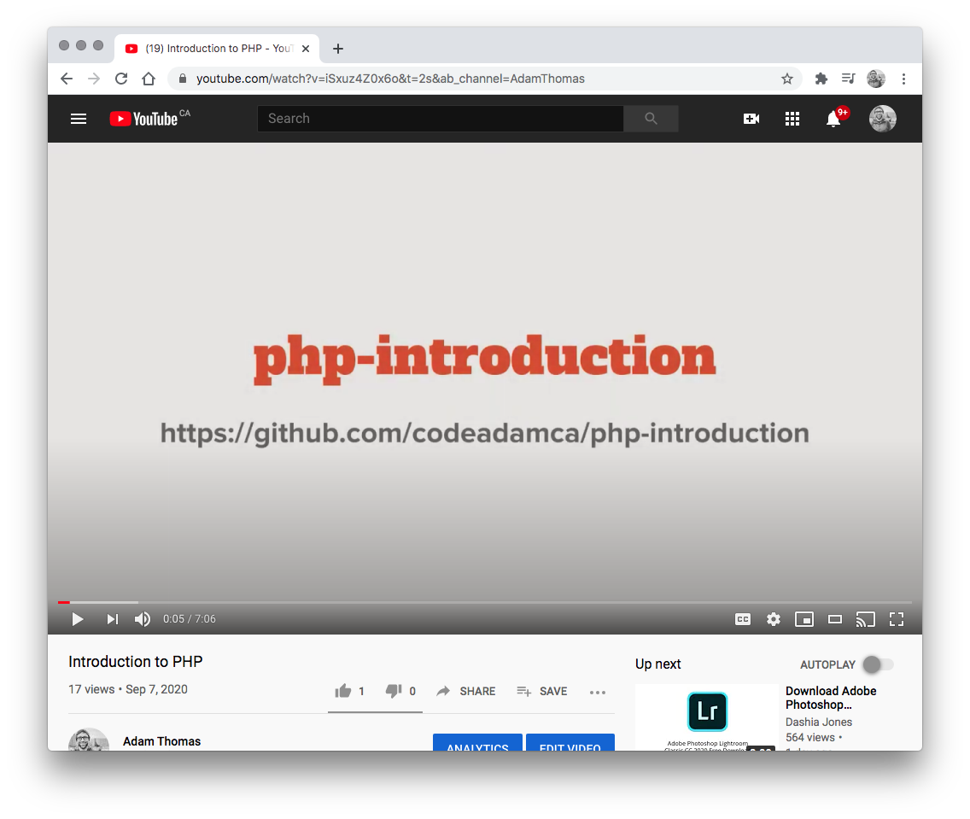

1. YouTube Videos
Watch the Following Youtube Videos:
PHP, SQL, and MySQL https://www.youtube.com/watch?v=szdud5z4AhM

Slide 3
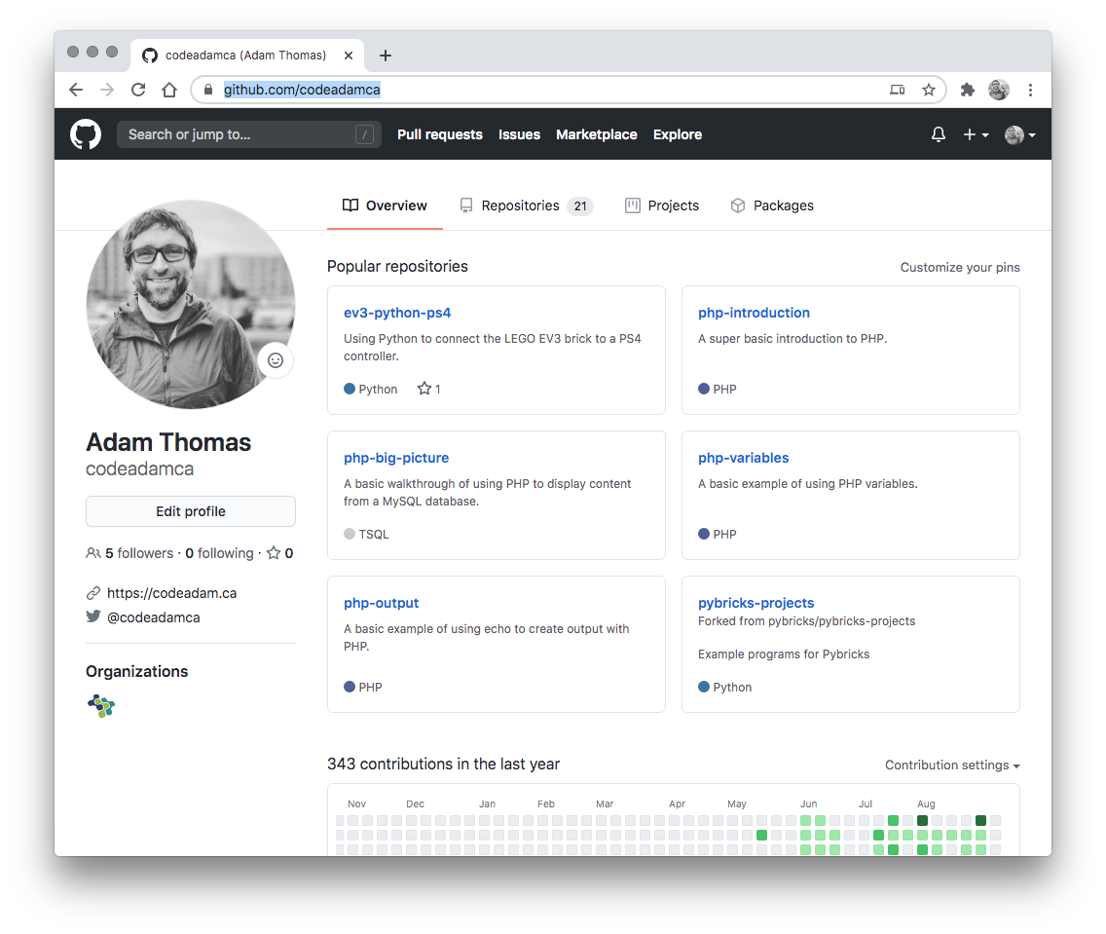

2. Review Code
Review the provided code and follow along with any coding instructions in GitHub:
PHP, SQL, and MySQL https://github.com/codeadamca/php-sql-mysql

Slide 4
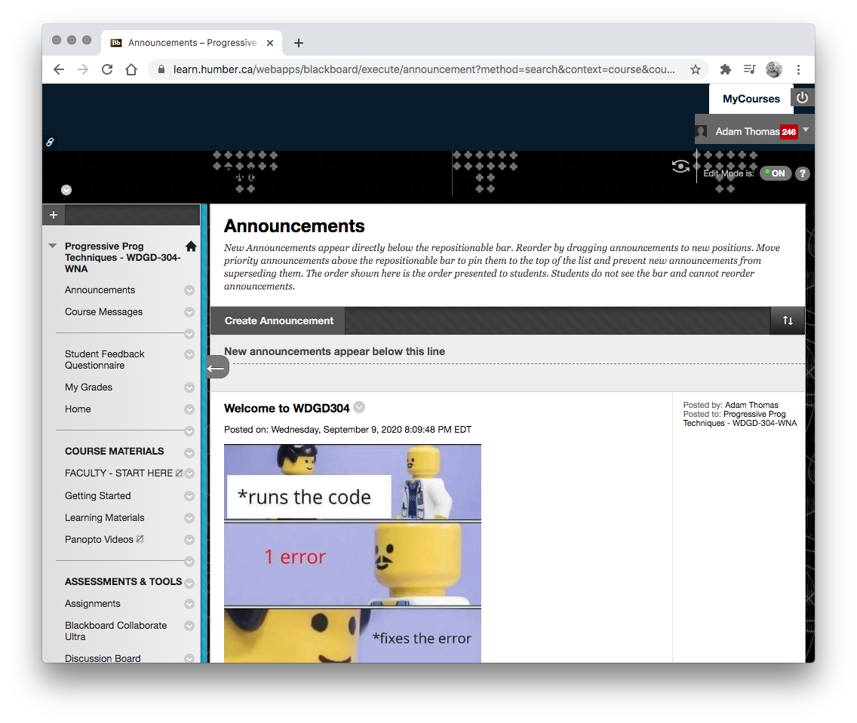
3. Assignments
Start your first PHP assignment.
Your first PHP assignment will also be done as individuals.
You will be required to create a table using PHPMyAdmin and us PHP to display the content from the database on a web page.

Slide 5
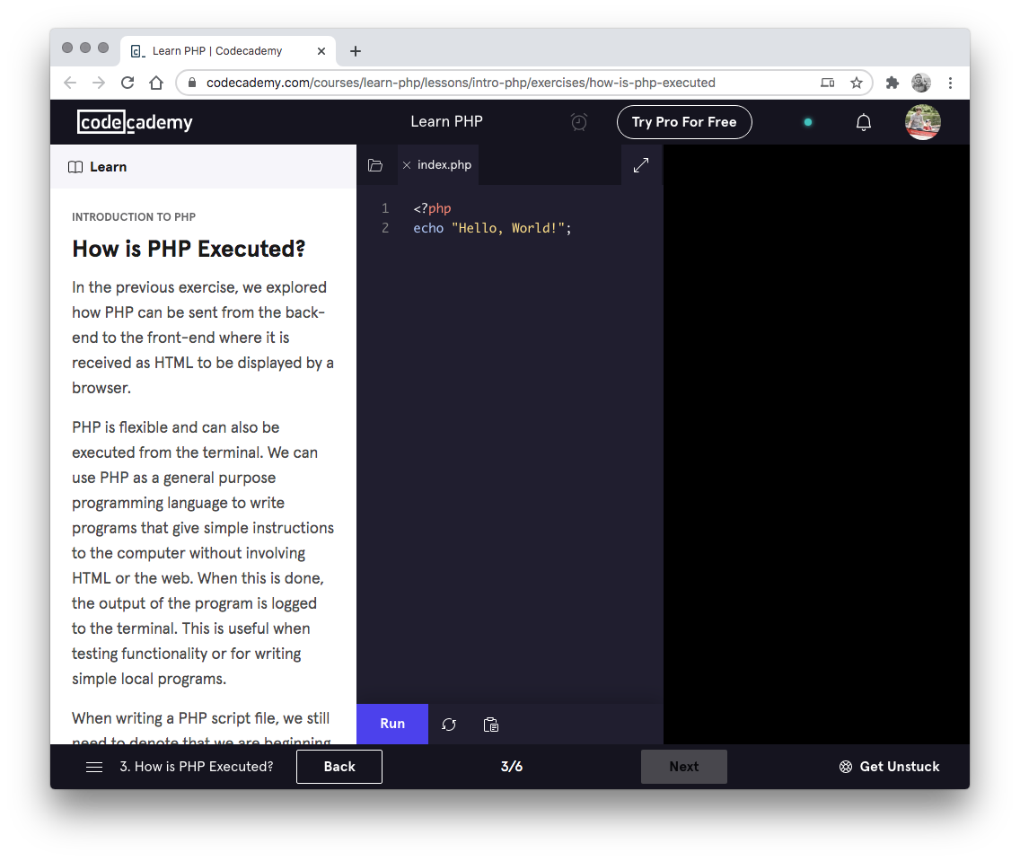

4. Codecademy
Complete the following Codecademy exercises:
PHP Functions: https://www.codecademy.com/learn/learn-php-functions

